Slide 1
Team 1: Operational Energy
Status Update: Data Collection
Bill Berklich
Christy Brennan
Steve Mazza
Dan Torres

Slide 2
Governance

Slide 3
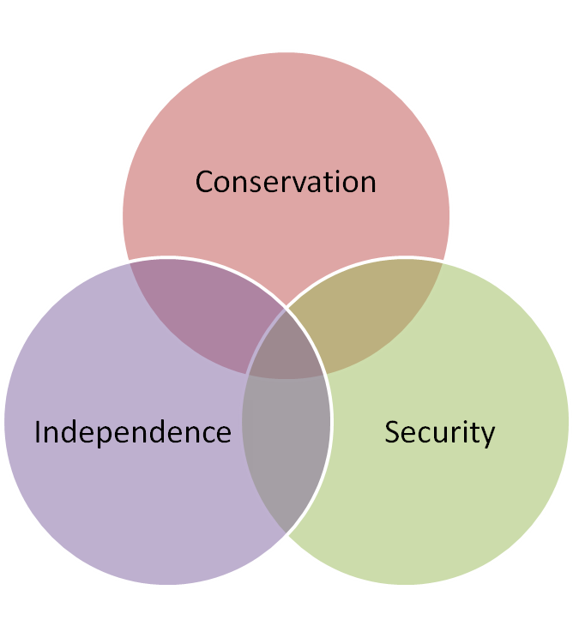
Literature Review
The literature seemed more than adequate to provide us with sufficient information to report on the status, direction, and impact of Operational Energy.
The principal areas of concern were conservation, security, and energy independence.

Slide 4
Initial Findings

Slide 5
Effectiveness of SoS
The SoS is achieving it’s mission of distributing the supplies to the troops however it is currently inefficient
  Extremely costly
  Dependent upon fossil fuels
  Excess supplies
  Assets lost during transit
  Unforeseen consequences of improvements
Current ICD in place to improve many of these issues for all systems in terms of energy – specifically focused on distribution and basing

Slide 6
Characteristic Estimates
Current characteristic estimations are relatively accurate, the current distribution system operates somewhere between a virtual and collaborative system
  Systems are independent
  Many uses of platforms but come together for a single mission (ie MRAPs used as convoy protection, route clearance and combat missions)
  Due to the fact that it is not a single cohesive system, it is difficult to anticipate and reduce the risks of the overall system
Emerging efforts are working to provide a more centralized management system and analyze the system as a more collaborative to acknowledged SoS
  Joint Operational Energy Initiative (JOEI) lead by PEO CS&CSS and TARDEC

Slide 7
Emergent Patterns
“Energy has emerged as a dominant factor in the 21st century battle space…energy inefficiency is a significant liability, a constraint on operations, and a significant force protection challenge.” –OE Metrics
New energy solutions need to be assessed against an overarching energy KPP and interactions fully understood
  Decreased reliability
  Increased burden related systems (ie waste to energy)
  Specialized maintenance creating need for new training and more men on bases
Need a holistic solution to the energy supply and demand situation
Insufficient efforts currently exist to address operational energy as a System of Systems
Understanding the interactions in the energy infrastructure is critical to improving operational energy

Slide 8

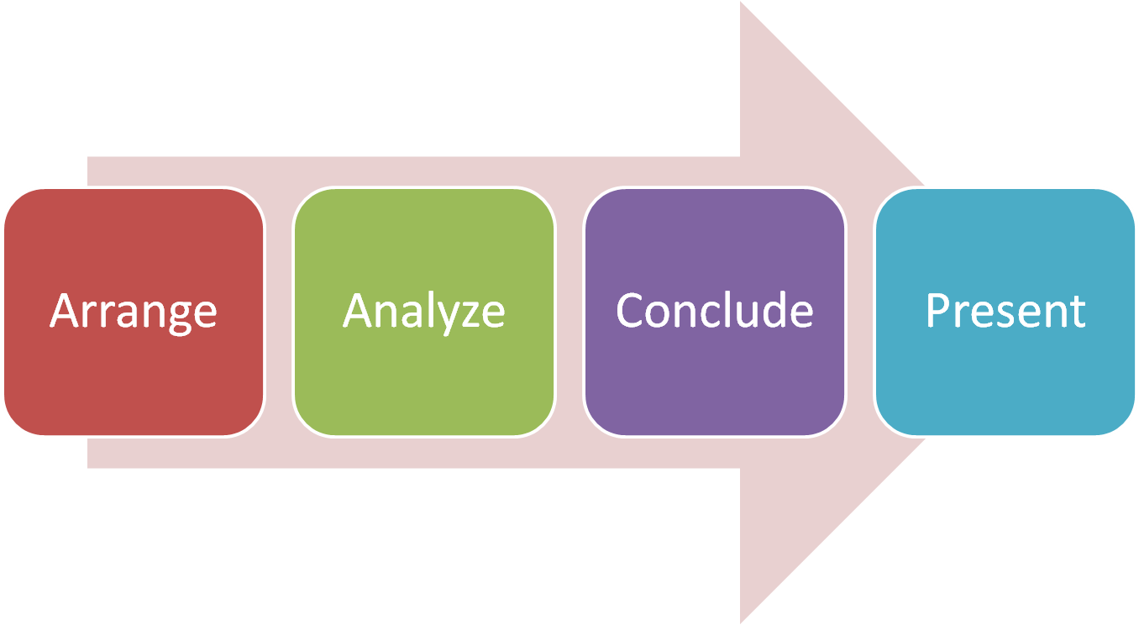
Next Steps
Notes:
These map to the syllabus.

